Slide 1
RUSTikales Rust for beginners

Slide 2
Plan for today

Slide 3
Plan for today
Introduction

Slide 4
Plan for today
Introduction
Rust Installation

Slide 5
Plan for today
Introduction
Rust Installation
Development Environment

Slide 6
Plan for today
Introduction
Rust Installation
Development Environment
General Info

Slide 7
Introduction
Welcome to this Rust course!

Slide 8
Introduction
Welcome to this Rust course!
Your life will change forever soon, you will be learning the best language in the world!!!

Slide 9
Introduction
Welcome to this Rust course!
Your life will change forever soon, you will be learning the best language in the world!!!
It‘s memory safe!
It‘s statically typed!
It‘s fast!
Zero Cost Abstraction!

Slide 10
Introduction
Welcome to this Rust course!
Your life will change forever soon, you will be learning the best language in the world!!!
It‘s memory safe!
It‘s statically typed!
It‘s fast!
Zero Cost Abstraction!
Well, not quite, but you‘ll see once we get there

Slide 11
Introduction
What will we be learning this semester?

Slide 12
Introduction
What will we be learning this semester?
Working with the Rust Compiler rustc

Slide 13
Introduction
What will we be learning this semester?
Working with the Rust Compiler rustc
Working with the Rust tool cargo
cargo init/new
cargo build
cargo run

Slide 14
Introduction
What will we be learning this semester?
Working with the Rust Compiler rustc
Working with the Rust tool cargo
Working with IDEs
Visual Studio Code + rust-analyzer
RustRover

Slide 15
Introduction
What will we be learning this semester?
Working with the correct tools
Basic Rust-Syntax and Rust-specific quirks

Slide 16
Introduction
What will we be learning this semester?
Working with the correct tools
Basic Rust-Syntax and Rust-specific quirks
Basics of Programming
Variables
Types
How do computers execute code?

Slide 17
Introduction
What will we be learning this semester?
Working with the correct tools
Basic Rust-Syntax and Rust-specific quirks
Basics of Programming
Control Flow
if
loop
match
fn

Slide 18
Introduction
What will we be learning this semester?
Working with the correct tools
Basic Rust-Syntax and Rust-specific quirks
Basics of Programming
Control Flow
Data Structures
struct
enum

Slide 19
Introduction
What will we be learning this semester?
Working with the correct tools
Basic Rust-Syntax and Rust-specific quirks
Basics of Programming
Control Flow
Data Structures
What makes Rust different from other languages
Ownership
Borrow Checking
Option<T> and Result<T,E>

Slide 20
Introduction
What will we be learning this semester?
Working with the correct tools
Basic Rust-Syntax and Rust-specific quirks
Dipping into advanced-ish topics
Traits
Generics
Third-party libraries

Slide 21
Introduction
What will we be learning this semester?
Working with the correct tools
Basic Rust-Syntax and Rust-specific quirks
Dipping into advanced-ish topics
What I will not cover
unsafe
async
Macros
Multithreading
Functional Programming

Slide 22
Introduction
Where can I find resources?
Official Rust website:
https://www.rust-lang.org/learn/
Rust Book:
https://doc.rust-lang.org/book/
Rustlings (official Rust exercises):
https://rustlings.cool/
Repo for this course:
https://github.com/pfhaupt/progkurs/
subdirectory rust-beginner

Slide 23
Rust Installation

Slide 24
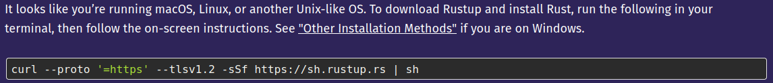
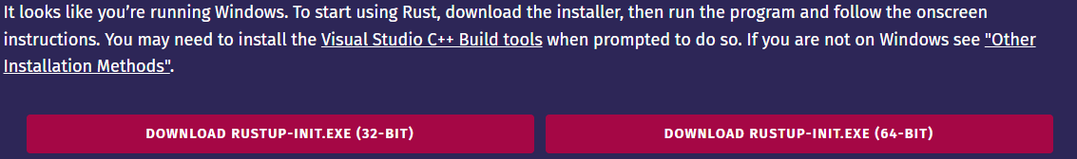
Rust Installation
Linux/macOS
Go to `rust-lang.org`
Click `Get Started`
Run this command in your terminal
You may need to also install a linker
you’ll see later when the example fails
You’re ready to go!
Windows
Go to `rust-lang.org`
Click `Get Started`
Download the Installer
Run the Installer
You may need to also install MSVC Tools
Installer will tell you, Quick Install is okay
Pray that eduroam doesn’t blacklist the MSVC Installer again :^)

Slide 25
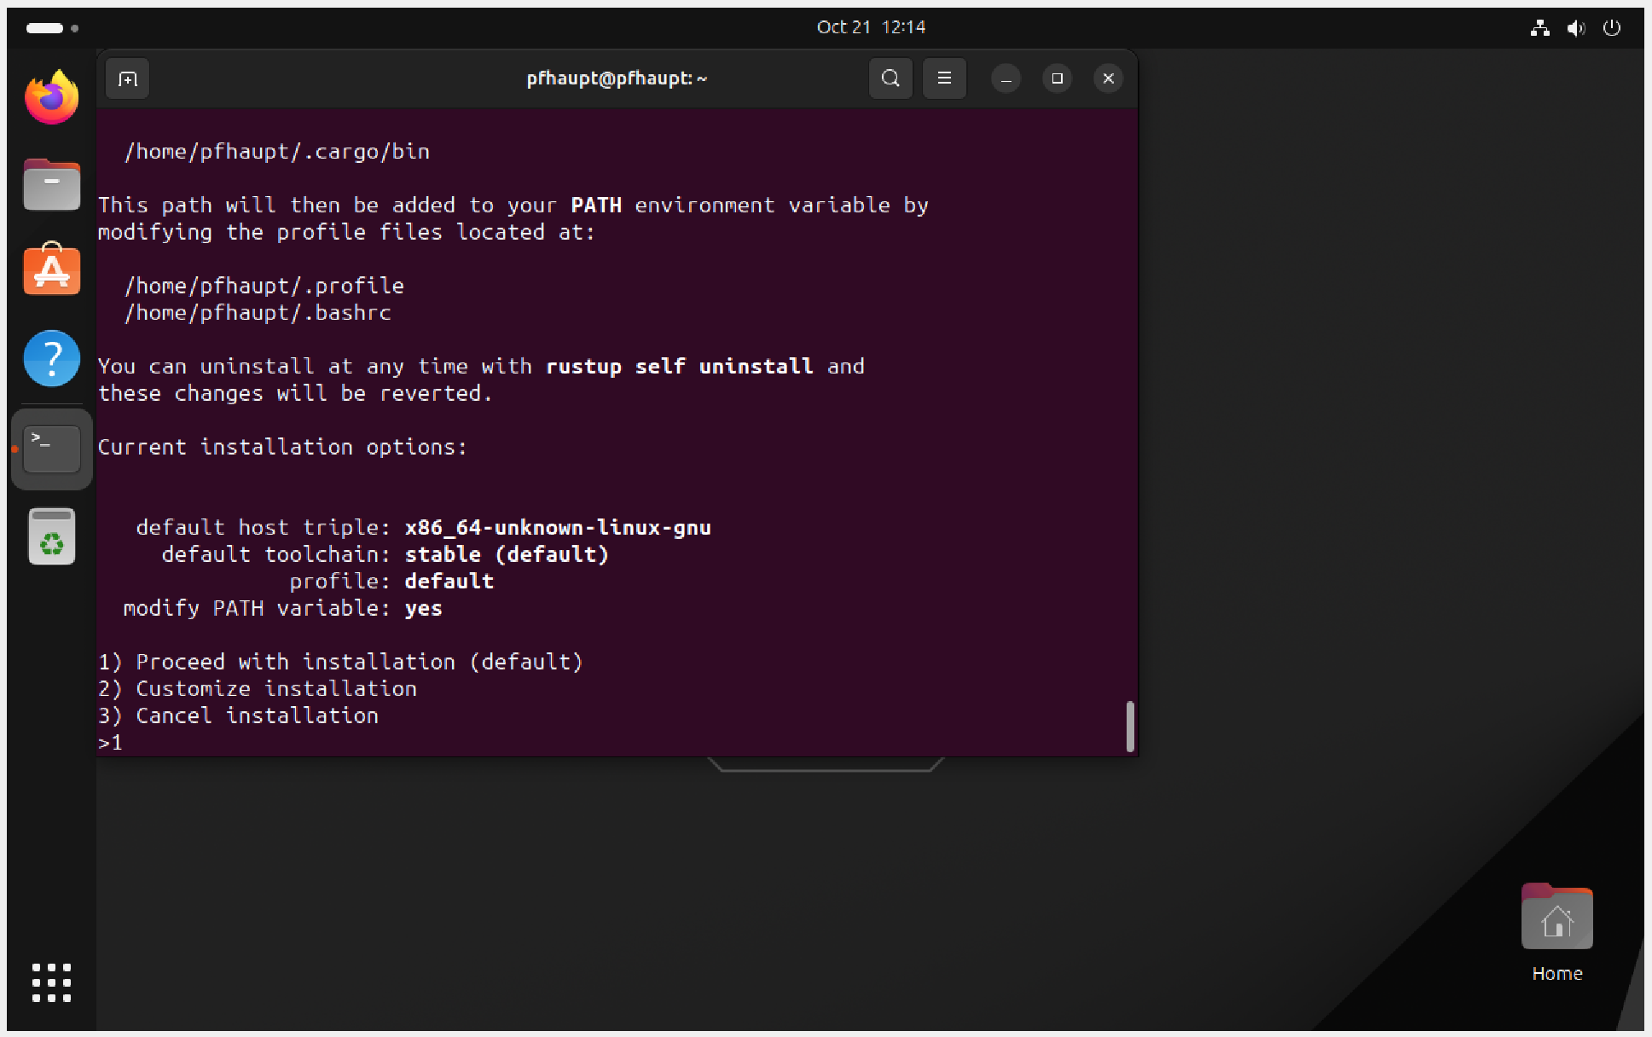
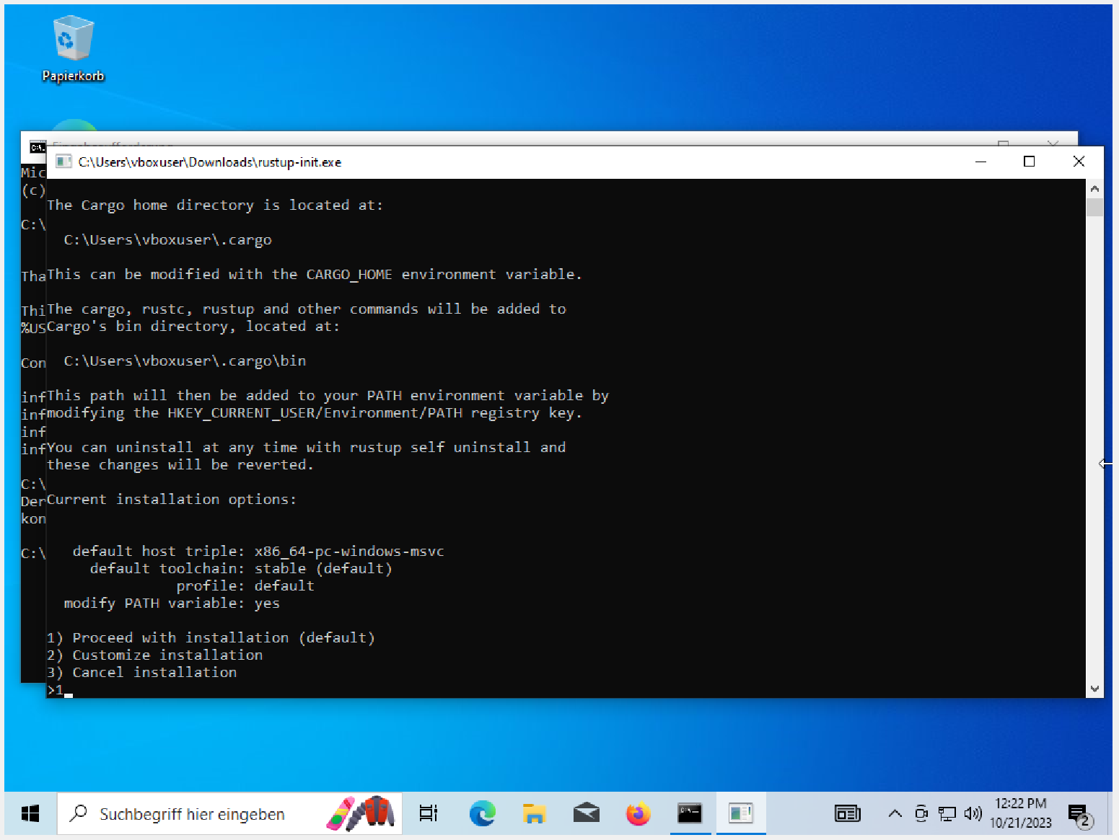
Rust Installation
Linux/macOS
Windows
If you see this, you’re almost done! It will now install all necessary tools.
Restart your terminal, and you’ll be able to use rustc and cargo!

Slide 26
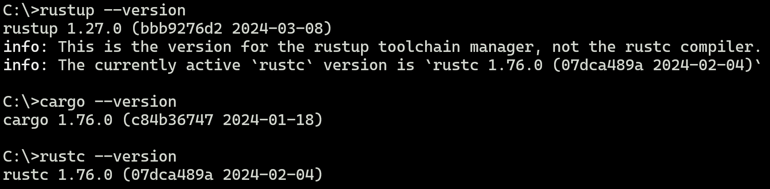
Rust Installation
if Installation was successful, you should be able to run the following commands:

Slide 27
Rust Installation
if any of those commands failed, we must troubleshoot now

Slide 28
Rust Installation
if any of those commands failed, we must troubleshoot now
common errors:
`Linker cc not found`
Linux → sudo apt install gcc
macOS → brew install gcc
Windows → shouldn’t happen, the Installer installed the MSVC toolchain :^)
eduroam may block downloading the Installer → you’d need to try again at home

Slide 29
Rust Installation
To test if everything is set up properly, run those commands:
Create a directory of your choice
Either via file manager, or terminal
Open that directory in a terminal
type in cargo new test_program
Navigate into that directory with cd test_program
type in cargo run
if you see Hello, world!, you’re ready to go!

Slide 30
Development Environment
Technically it doesn’t matter, you could even use Ed, Notepad, Word…

Slide 31
Development Environment
Technically it doesn’t matter, you could even use Ed, Notepad, Word…
There are some IDEs and Editors that make programming [in Rust] easier

Slide 32
Development Environment
Technically it doesn’t matter, you could even use Ed, Notepad, Word…
There are some IDEs and Editors that make programming [in Rust] easier
JetBrains RustRover → Free license for CS-students with a University-email
Emacs, Vim → For those who prefer terminal editors
Visual Studio Code → What I’ll be using

Slide 33
Development Environment
Technically it doesn’t matter, you could even use Ed, Notepad, Word…
There are some IDEs and Editors that make programming [in Rust] easier
VSC → https://code.visualstudio.com/
Windows → Simply follow the Installer
Linux → https://code.visualstudio.com/docs/setup/linux
macOS → https://code.visualstudio.com/docs/setup/mac

Slide 34
Development Environment
Visual Studio Code itself does not have builtin Rust-Support, only Syntax Highlight – It‘s just a Text Editor
Using extensions, we can fix that

Slide 35
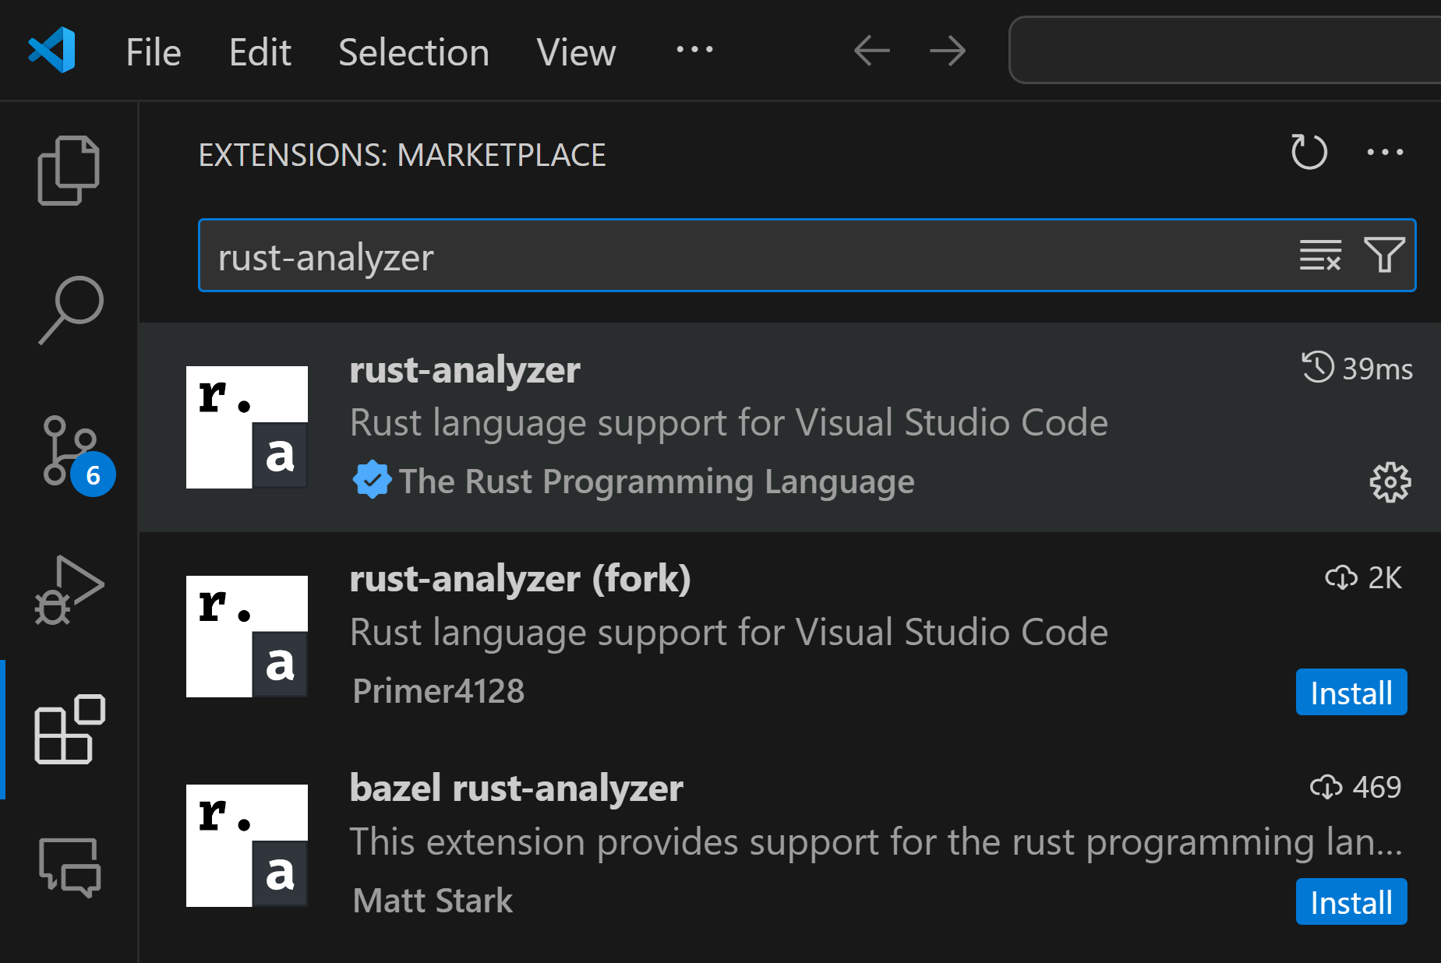
Development Environment

Slide 36
Development Environment
Extensions

Slide 37
Development Environment
Search for this term

Slide 38
Development Environment
The one with the checkmark is what we want

Slide 39
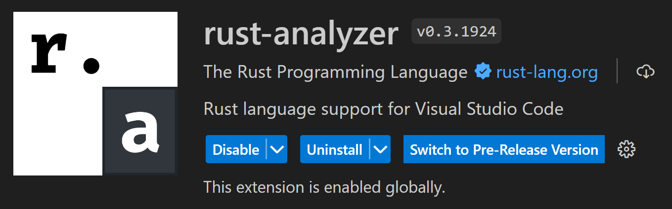
Development Environment
As extensions can run arbitrary code, make sure it‘s the right one :^)

Slide 40
Development Environment
Somewhere here should be an Install-button
Restart VSC if necessary

Slide 41
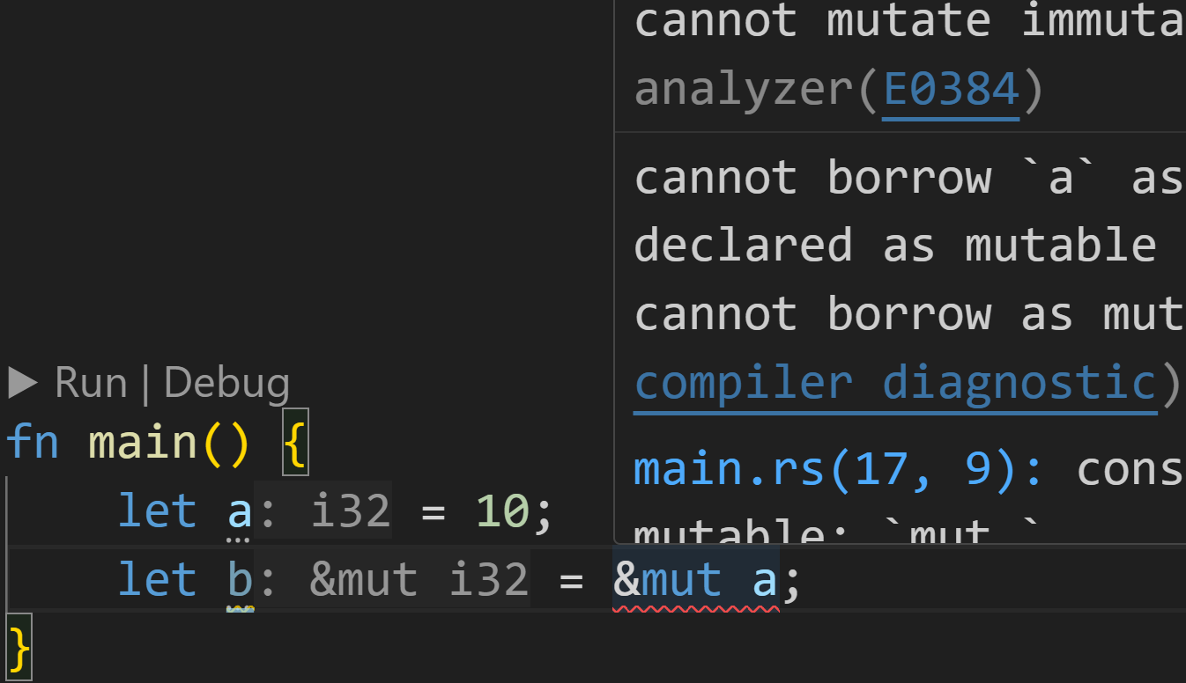
Development Environment

Slide 42
Development Environment
We can run our code from within VSC

Slide 43
Development Environment
Direct error reporting in our editor, without compiling ourselves

Slide 44
Development Environment
Diagnostics when hovering over the red swiggly lines of death :^)

Slide 45
General Info
Slides are available at the mentioned Github repository

Slide 46
General Info
Slides are available at the mentioned Github repository
I highly recommend using the default git way of getting the repository
git is very important, it‘s best to start early
Because I am still changing slides, regular updates are recommended
Initial Step:
Go to the Github repository
Click the green Code button, copy the HTTPS-url to your clipboard
Go to a directory of your choice, open the terminal there
type in git clone <paste URL here>
In the future, to get the updated slides:
Simply go to that directory (or rather, the progkurs directory inside)
type in git pull
You now have access to the current state of all slides and exercises

Slide 47
General Info
Slides are available at the mentioned Github repository
Every session will be split into three parts
Recap of last session
New topics
Exercises at the end

Slide 48
General Info
Slides are available at the mentioned Github repository
Every session will be split into three parts
Exercises and some Code snippets in future slides will be color coded
Green → 0/3 → We have covered the topic already, should be easy enough
Yellow → 1/3 → We have just covered the topic, may be hard
Red → 2/3 → Same as Yellow, but trickier
Purple → 3/3 → We have not covered the topic, but challenges are always fun

Slide 49
General Info
Slides are available at the mentioned Github repository
Every session will be split into three parts
Exercises and some Code snippets in future slides will be color coded
Every session contains a file with exercises called exercises.md
Exercises will not be fully compared every time
Important points will be mentioned in each Recap
Example solutions are in a file called solutions.md

Slide 50
General Info
Slides are available at the mentioned Github repository
Every session will be split into three parts
Exercises and some Code snippets in future slides will be color coded
Every session contains a file with exercises called exercises.md
Example solutions are in a file called solutions.md
Participation and Feedback is very important
Basic program stands, but my goal is to teach you Rust the best I can
Don‘t understand something? Am I too fast? Did I make any mistakes?
Just raise your hand, and we can discuss a topic for a while! ☺

Slide 51
Next time
rustc vs cargo
Basic Types
Variables
let vs let mut

